Slide 1


ITC 6000 Database Management Systems Final Project Presentation 2023 Term A Comprehensive Database Design for Retail Management System
Mohammed Saif Wasay NUID: 002815958
Mohammed.saif@northeastern.edu

Slide 2
Overview and Agenda
Project Overview
User Persona’s
Business Rules
ER Diagram
Major SQL examples
Metrics and Analysis
Security & Privacy Concerns
System Architecture & Hosting Strategy
Lessons learned and Future Considerations

Slide 3
Project Overview
The Retail Management System:
A technological solution designed to optimize retail operations.
Utilized by a diverse range of businesses for managing products, sales, inventory, and customer interactions.
Central to data-driven decision-making in retail environments.

Slide 4
Project Overview
System Scope and Cost Model:
Serves small local retailers to large-scale chains.
Freemium model: Basic features free, advanced features under subscription.
Subscription options tailored to different business sizes and needs.

Slide 5
Personas
Key User Personas:
Store Manager: Uses the system for inventory management and sales strategy optimization.
Sales Representative: Processes transactions and manages customer experience.
Inventory Manager: Focuses on stock levels and efficient restocking.

Slide 6
Persona Example
Store Manager:
Uses the app to gain real-time insights into sales performance, monitor inventory levels, and make data-driven decisions to optimize the store's profitability.
Access comprehensive dashboards, review sales reports, set promotional strategies, and analyze customer trends for effective inventory planning.
Sales Representative:
Utilizes the app to streamline the sales process, access detailed product information, and provide personalized recommendations to customers.
Engages with the app to process transactions, check product availability, and access customer purchase history.

Slide 7
Business Rules and Logic
Product must belong to a predefined category.
Unique identification of employees for transaction tracking.
Real-time updates on inventory and sales data.
Data consistency and referential integrity are crucial.
All transactional data must be encrypted using industry-standard methods for security.
Products sold as bundles must be defined with specific component items and pricing.

Slide 8
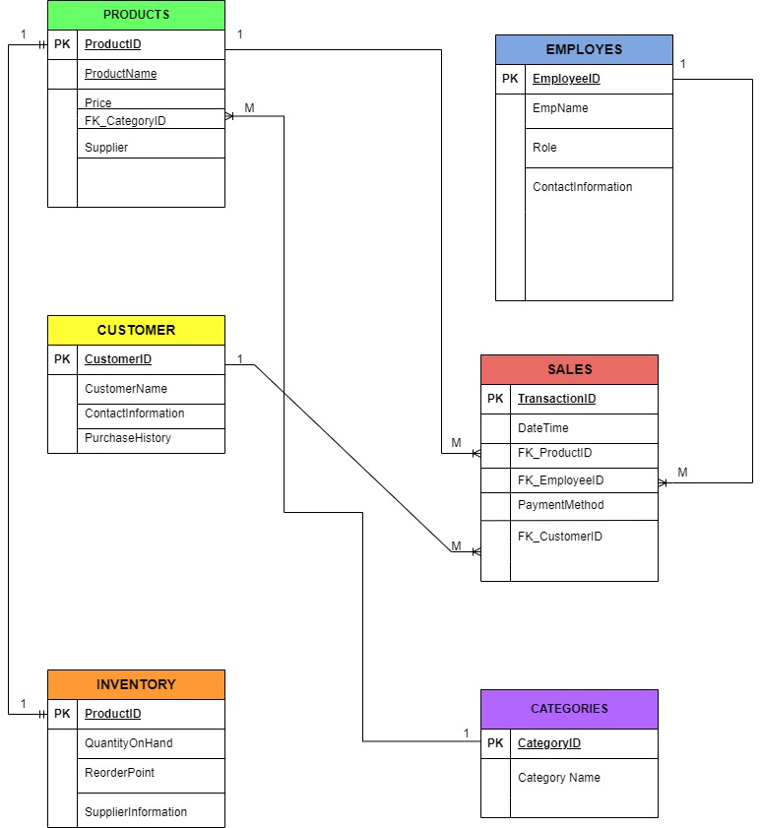
ER Diagram

Slide 9
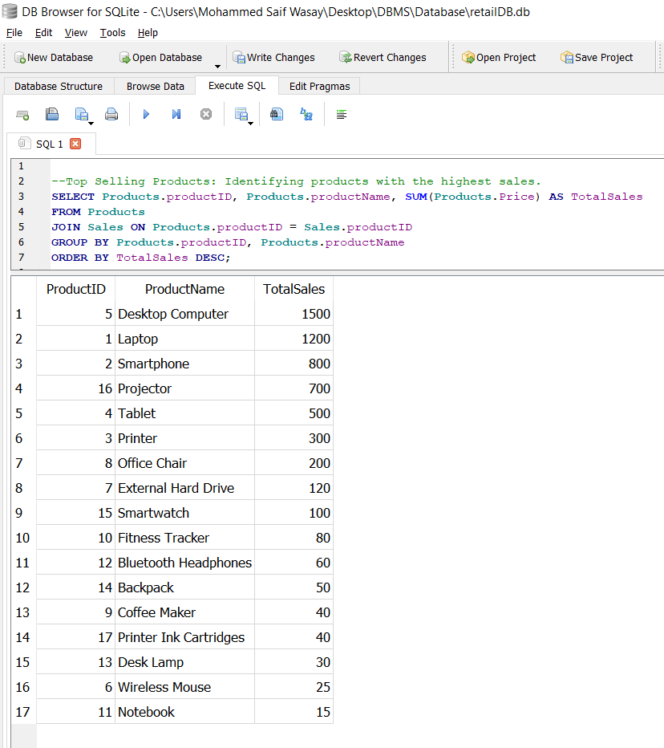
SQL Example: 1
Identifying products with the highest sales
Query: SELECT Products.productID, Products.productName, SUM(Products.Price) AS TotalSales FROM Products JOIN Sales ON Products.productID = Sales.productID GROUP BY Products.productID, Products.productName ORDER BY TotalSales DESC;
SELECT Clause: We're selecting three pieces of information:
productID and productName from the Products table to identify each product.
The SUM of Products.Price, labeled as TotalSales, to calculate the total revenue for each product.
FROM and JOIN Clause:
We're pulling this data from the Products table.
It's then joined with the Sales table where the productID matches, linking products to their sales records.
GROUP BY Clause:
The data is grouped by productID and productName. This ensures that the
SUM function aggregates sales revenue for each unique product.
ORDER BY Clause:
The results are ordered by TotalSales in descending order. This means the product with the highest sales revenue comes first in our list.

Slide 10
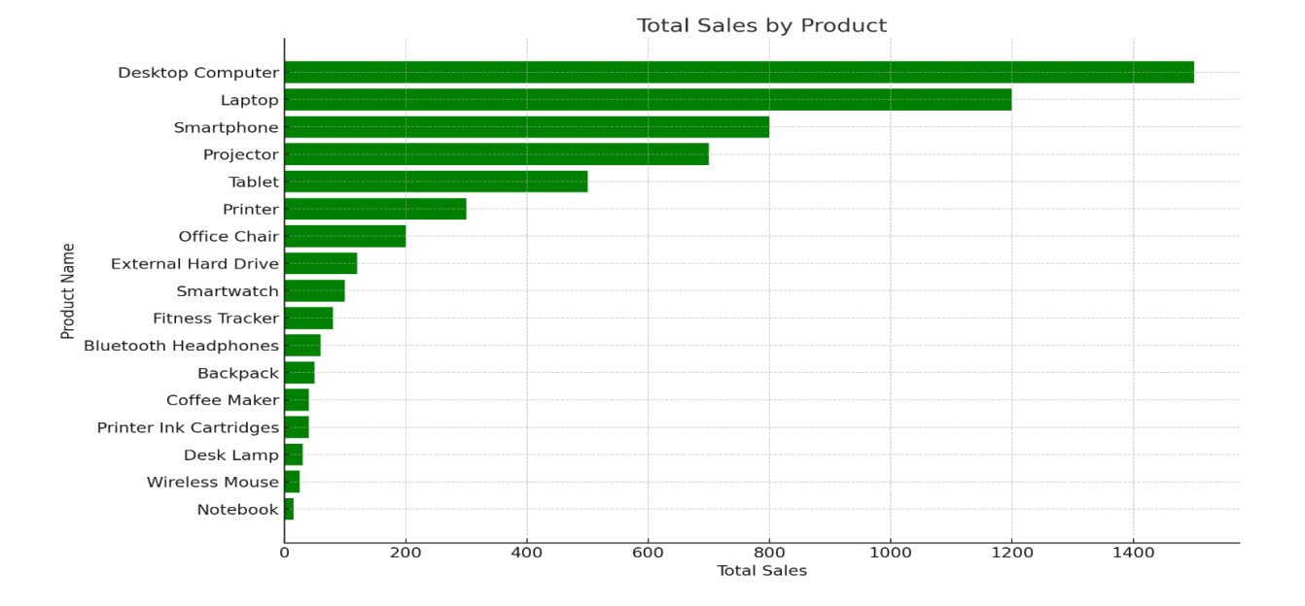
Metrics and Analytics
This bar graph illuminates the sales landscape, highlighting our top performers and underdogs. At the pinnacle, we see 'Desktop Computers' leading the charge with sales towering at 1500 units.

Slide 11
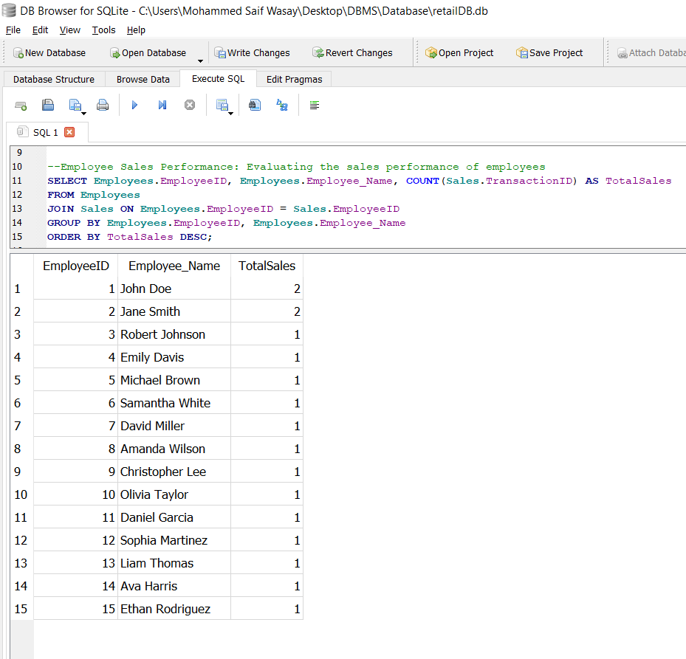
SQL Example: 2
Evaluating the sales performance of employees
Query: SELECT Employees.EmployeeID, Employees.Employee_Name,
COUNT (Sales.TransactionID) AS TotalSales FROM Employees JOIN Sales
ON Employees.EmployeeID = Sales.EmployeeID GROUP BY Employees.EmployeeID, Employees.Employee_NameORDER BY TotalSales DESC;
SELECT Clause: We're selecting the following fields:
Employees.EmployeeID and Employees.Employee_Name to identify each employee.
The COUNT(Sales.TransactionID) function counts the number of transactions per employee, labeled as TotalSales.
FROM and JOIN Clause:
We're pulling this data from the Employees table.
It's then joined with the Sales table where the EmployeeID matches, linking employees to their sales records.
GROUP BY Clause:
The data is grouped by EmployeeID and EmployeeName. This ensures that the sales count is accurate for each individual employee.
ORDER BY Clause:
The results are ordered by TotalSales in descending order. This means the employees with the highest sales comes first in our list.

Slide 12
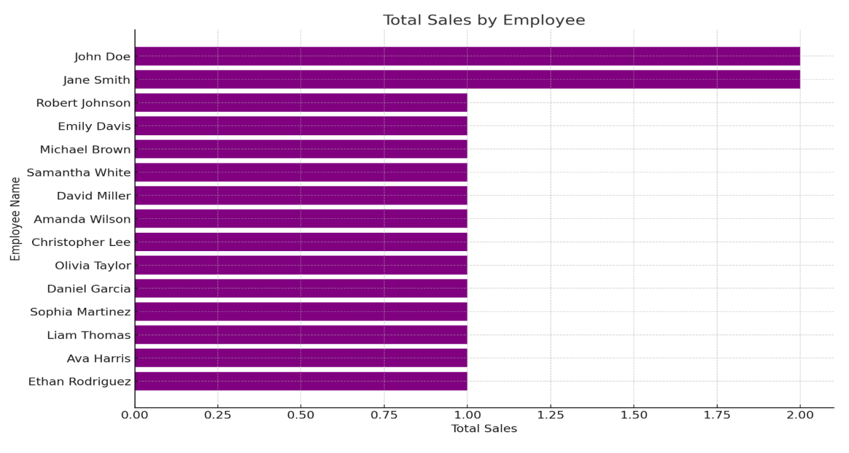
Metrics and Analytics
This bar chart presents a snapshot of total sales by each employee, highlighting contributions across our team. Notice how John and Jane stand out with twice the sales of their colleagues, indicative of their exceptional performance.

Slide 13
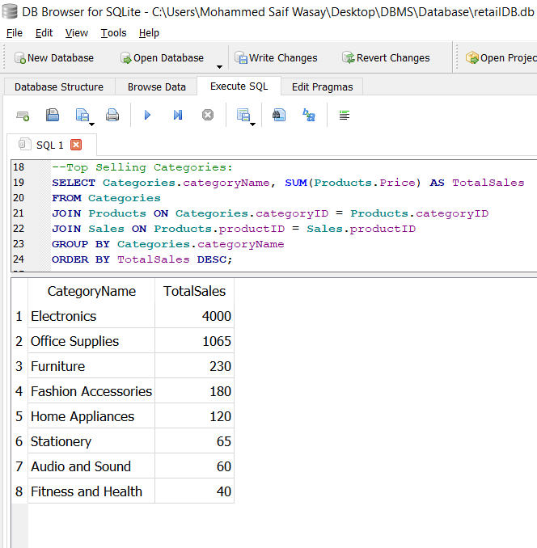
SQL Examples
Identifying Top Selling Categories
Query: SELECT Categories.categoryName, SUM(Products.Price) AS TotalSales
FROM Categories
JOIN Products ON Categories.categoryID = Products.categoryID
JOIN Sales ON Products.productID = Sales.productID
GROUP BY Categories.categoryName
ORDER BY TotalSales DESC;
SELECT Clause: We're selecting the following fields:
Categories.categoryName to identify the name of each category.
SUM(Products.Price) to sum up the sales amount per category, labeled as TotalSales.
FROM and JOIN Clause:
A join with the Products table matches categoryID from both tables to link products to their categories.
Another join with the Sales table connects productID to account for each sale of the products.
GROUP BY Clause:
The results are grouped by categoryName to ensure the sum of sales is calculated for each category separately.
ORDER BY Clause:
The categories are ordered by TotalSales in descending order to list the top-selling categories first.

Slide 14
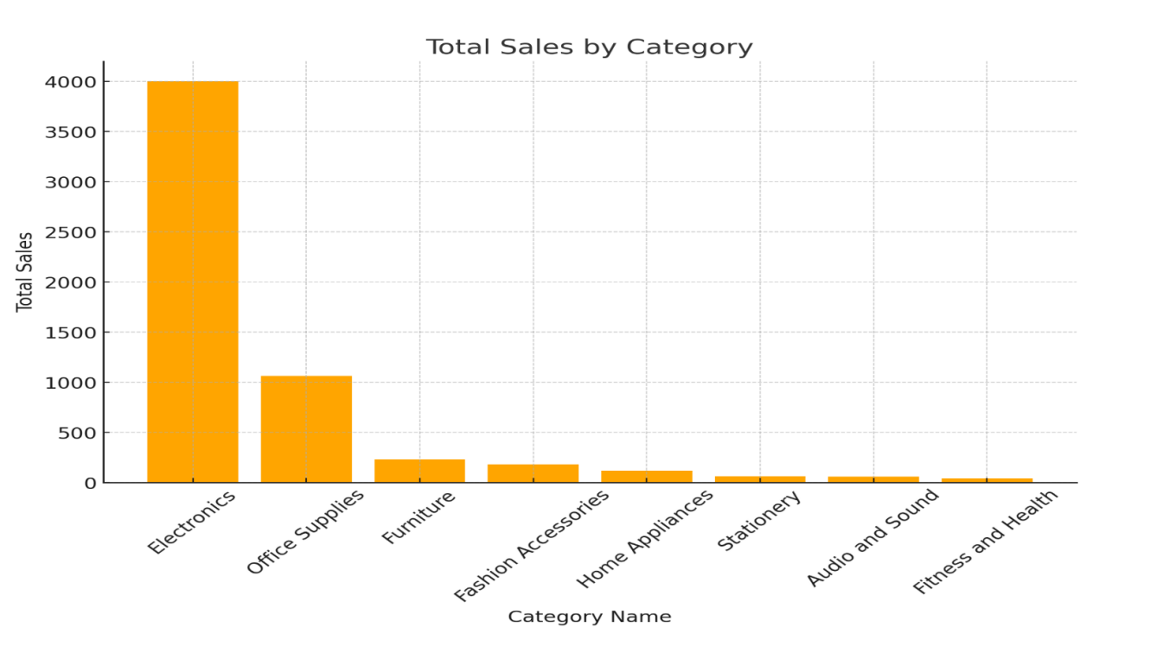
Metrics and Analytics
Dive into our sales data by category with this vivid bar chart. Electronics soar at the forefront, dominating with a sales volume of 4000 units.

Slide 15
Security and Privacy
1.Personal Customer Information
Concern: Risk of privacy breaches due to unauthorized access to the Customers table.
Mitigation: Implement strict access controls and robust authentication and encrypting sensitive customer data fields.
2. Financial Transaction Data
Concern: Potential for financial fraud from compromised Sales table data.
Mitigation: Using strong encryption protocols for financial data and regularly review access rights.

Slide 16
Security and Privacy
3. Employee Data:
Concern: The Employees table includes employee names and contact information. Unauthorized access could lead to identity theft or unauthorized use of employee details.
Mitigation: Apply role-based access controls, ensuring that only authorized personnel have access to employee data.
4. Inventory Management
Concern: The Inventory table holds information about stock levels and suppliers. Unauthorized access could lead to inventory manipulation, affecting supply chain operations.
Mitigation: Implement access controls to restrict inventory-related data access. Encrypt supplier information to protect relationships and agreements.

Slide 17
System Architecture & Hosting Strategy
Client/Server Architecture:
Centralized data control with enhanced security.
Simplified system maintenance and management.
Scalable design ready for future growth.
4. Cloud Hosting Benefits:
Scalability: Adjusts resources to meet demand fluctuations.
Accessibility: Facilitates remote access and collaboration.
Reliability: Ensures high availability and minimal downtime.
Cost-Efficiency: Offers a flexible, pay-as-you-go expense model.

Slide 18
System Architecture & Hosting Strategy
Storage Strategy:
Careful data type selection for storage optimization.
Routine backups for robust data recovery protocols.
Data encryption at rest and in transit for security compliance.
Infrastructure designed for easy scalability in response to growing data needs.

Slide 19
Lessons Learned
Key takeaways:
Acquired a deep understanding of user-centric database design.
Enhanced skills in crafting complex SQL queries for data analysis.
Recognized the paramount importance of stringent security measures.

Slide 20
Future Considerations
Next Plan:
Integrate predictive analytics for data-driven foresight.
Adopt iterative design for continuous improvement.
Focus on optimizing database performance for scalability.

Slide 21
Thank You

